Slide 1
CHAPTER 2: Introduction to Systems Concepts and Systems Architecture
The Architecture of Computer Hardware, Systems Software & Networking: An Information Technology Approach
4th Edition, Irv Englander
John Wiley and Sons ©2010

Slide 2
What is a system?
What do the following systems have in common?
Plumbing system
Solar system
Home network system
Inventory control system

Slide 3
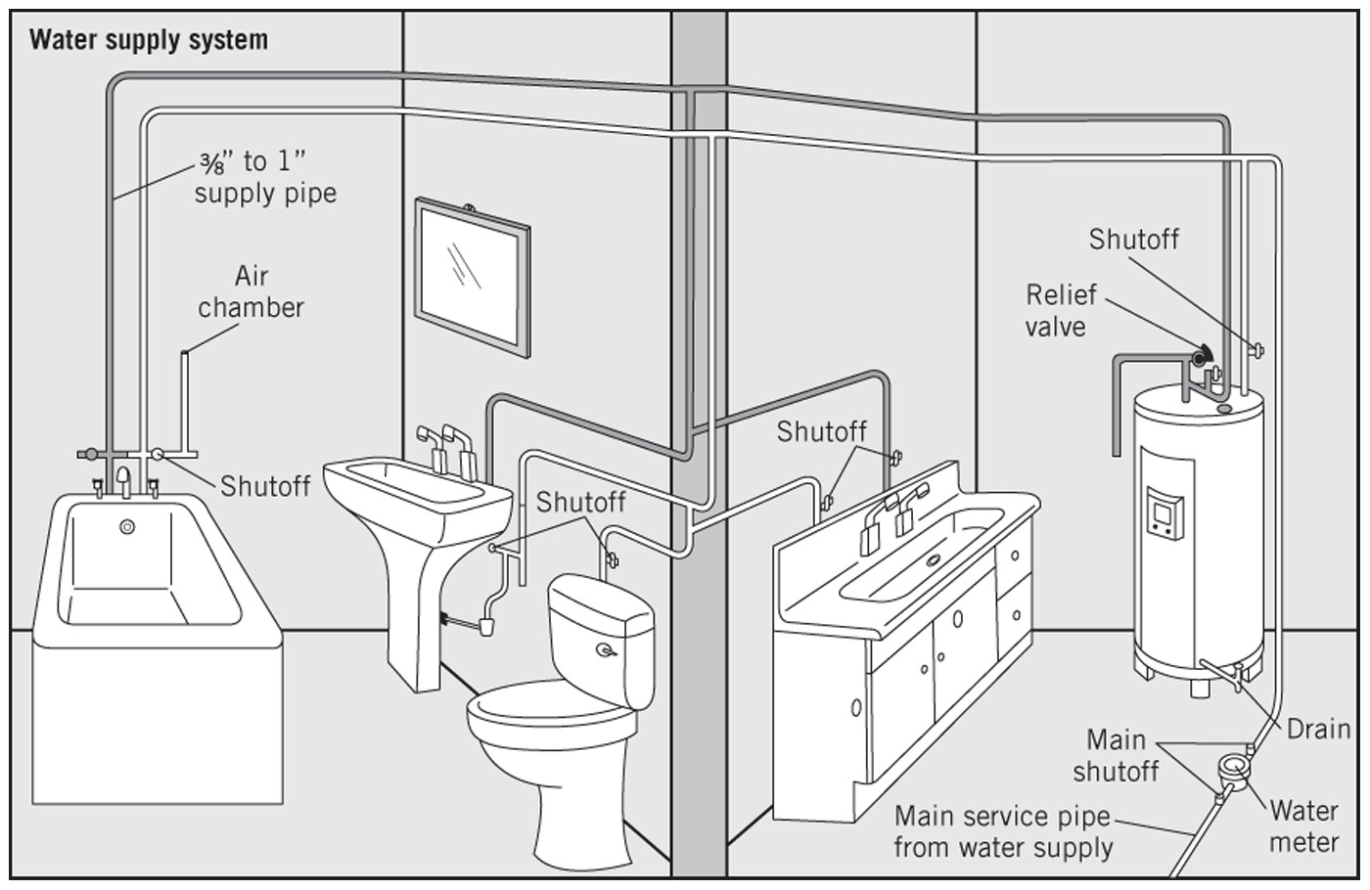
Plumbing System

Slide 4
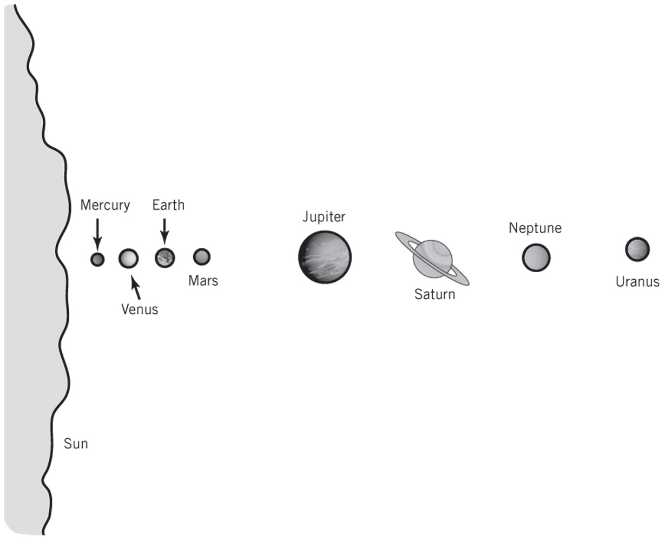
Solar System

Slide 5
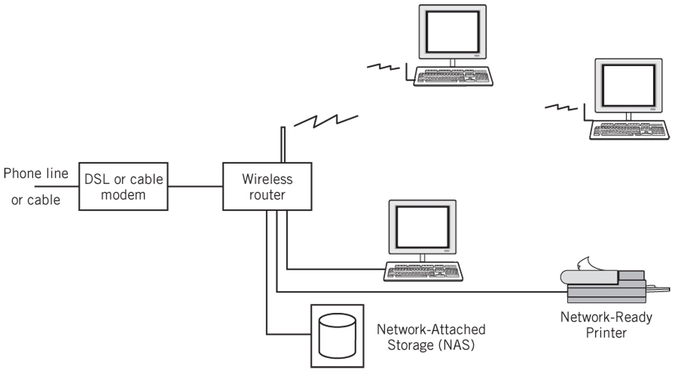
Home Network System

Slide 6
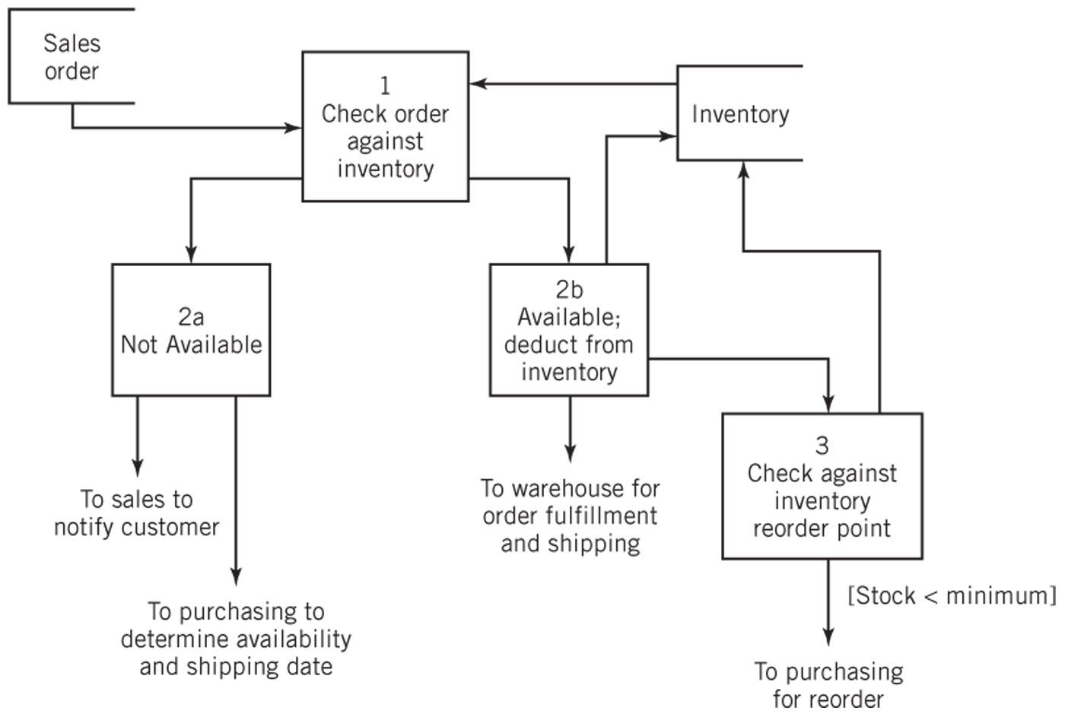
Inventory Control System

Slide 7
Definition of a System
“A system is a collection of components linked together and organized in such a way as to be recognizable as a single unit.”
Linked components of a system also define the boundary for the system
The environment is anything outside of the system
The interface via which the system communicates (input/output) with the environment

Slide 8
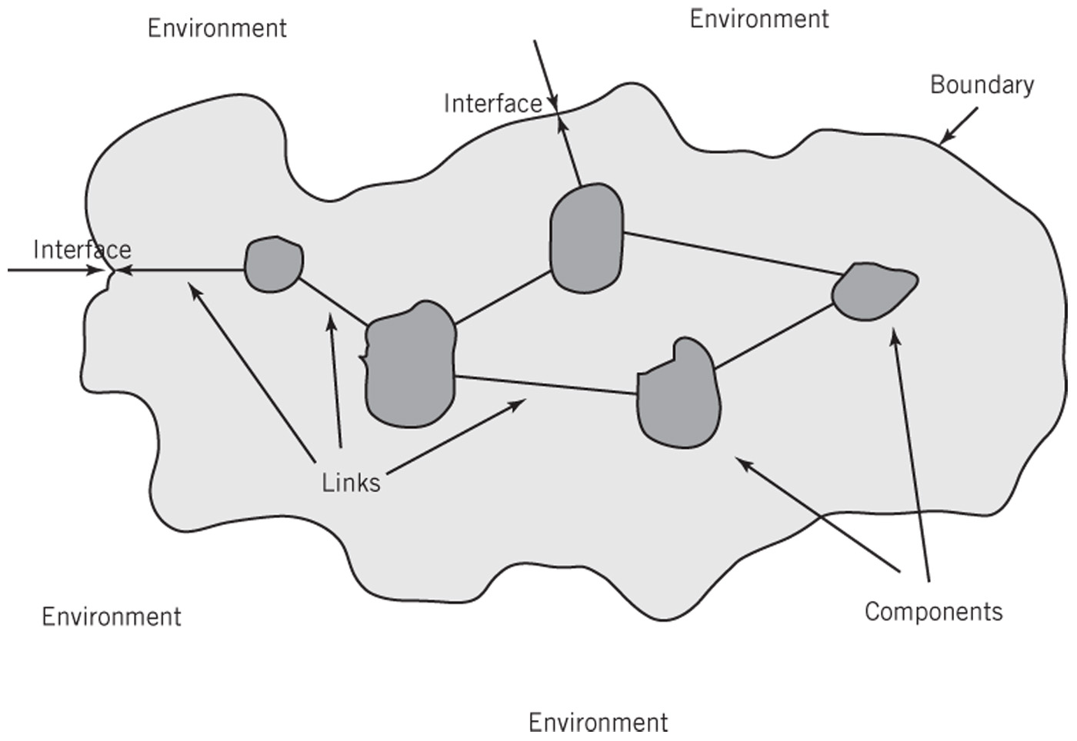
General Representation of a System

Slide 9
System Decomposition
Components
May be irreducible or
May be subsystems
Decomposition
The division of a system into its components (modules) and linkages in a top-down manner
Hierarchical
Improves the understanding of the system
Makes the system easier to analyze, design, manufacture/create its components, maintain, repair, and upgrade

Slide 10
System Architecture
“The fundamental properties, and the patterns of relationships, connections, constraints, and linkages among the components and between the system and its environment are known collectively as the architecture of the system”

Slide 11
Abstractions of Systems
Abstraction is a model or diagram representation (on paper) of the system
It is actually not the real system
Created to simplify the understanding and analysis of the system
How are the following two abstractions of a business system different from one another?
How are these abstractions different from the real business system?

Slide 12
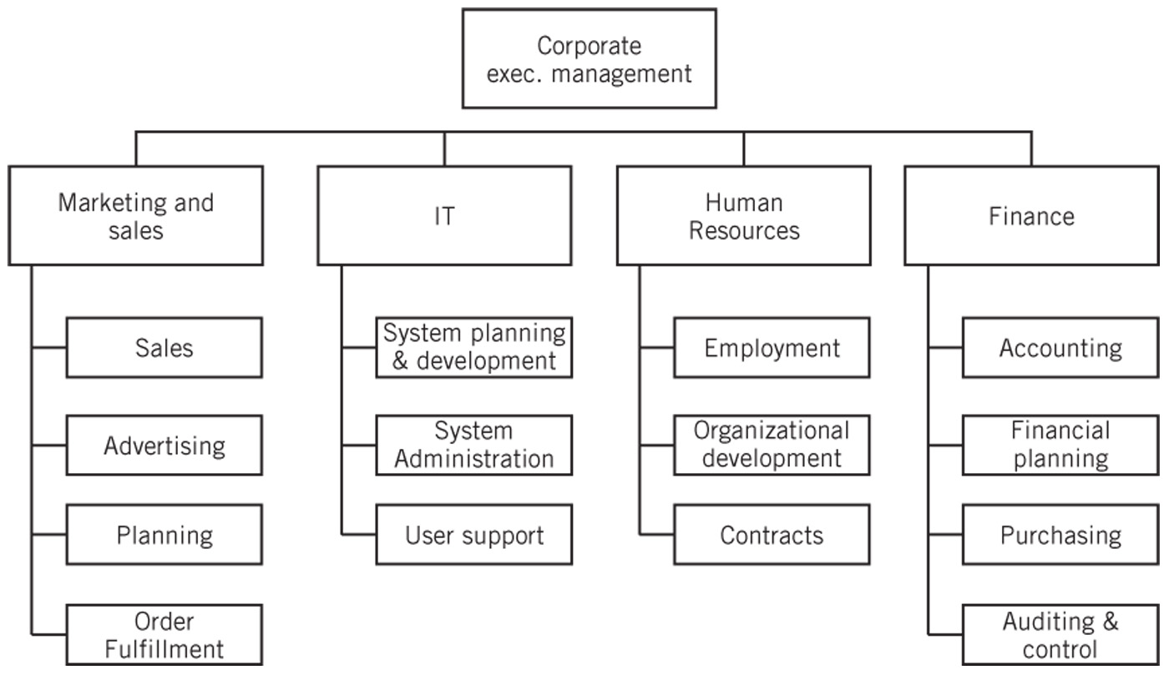
Business Organization Chart
Traditional hierarchical organization chart.

Slide 13
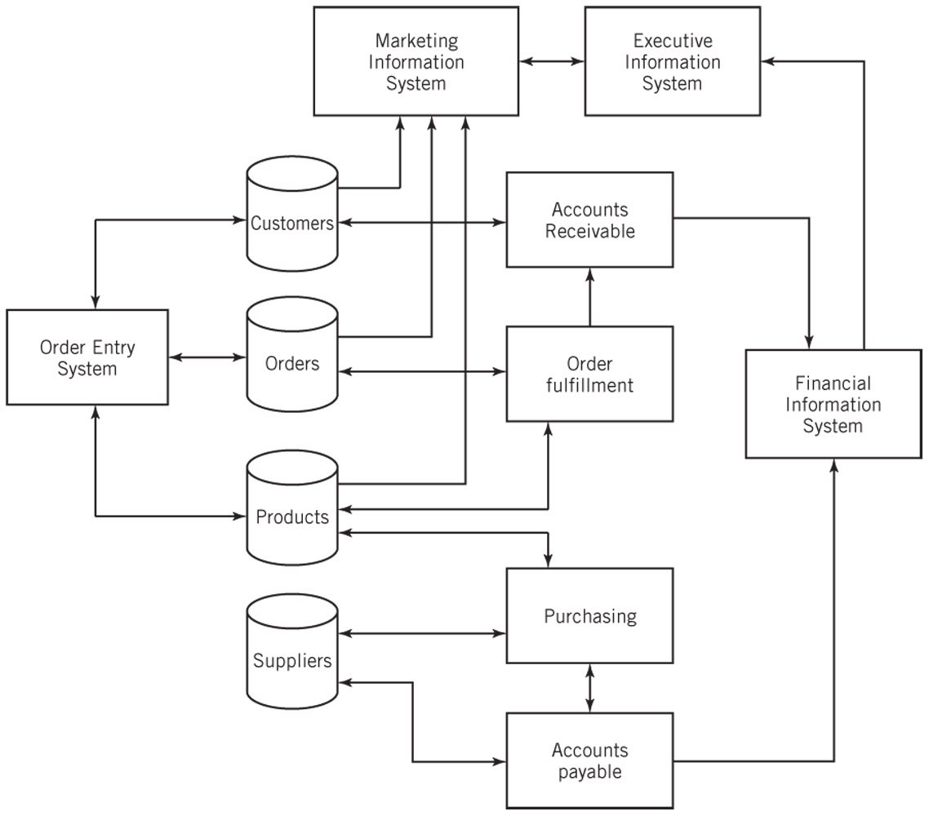
Business Application Architecture
Concerned with the activities and processing of application programs and the communications between them. Addresses the business needs of the organization. Not hierarchical.

Slide 14
Business Application Architecture
Selection of the hardware architecture, network architecture, and communication architecture to support the application software and its functionality is crucial
Additional factors may include scalability, ease of use, data and system security, system administration, and cost
This is what computer system architects, like you guys, will often do

Slide 15
IT System Architectures
Distributed (decentralized) processing systems
Client-Server Computing
2-tier architecture
3-tier architecture
N-tier architecture
Web-Based Computing
Peer-to-Peer Computing

Slide 16
Client-Server Computing
A program on a client computer requests services from a program on a server computer
Examples:
Email services, file services, print services, directory services, Web services, database services, application services, remote access services

Slide 17
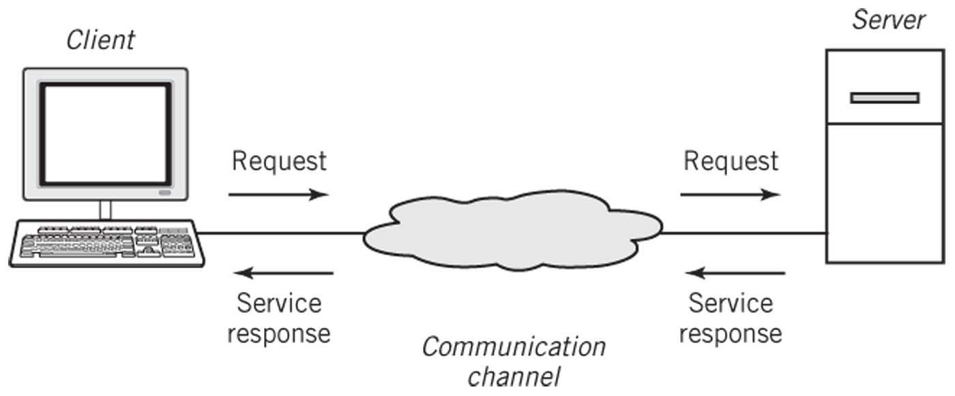
Basic Client-Server Architecture
Web browser sends HTTP request message: GET www.louisville.edu
Web server returns the page in HTML and the browser displays it

Slide 18
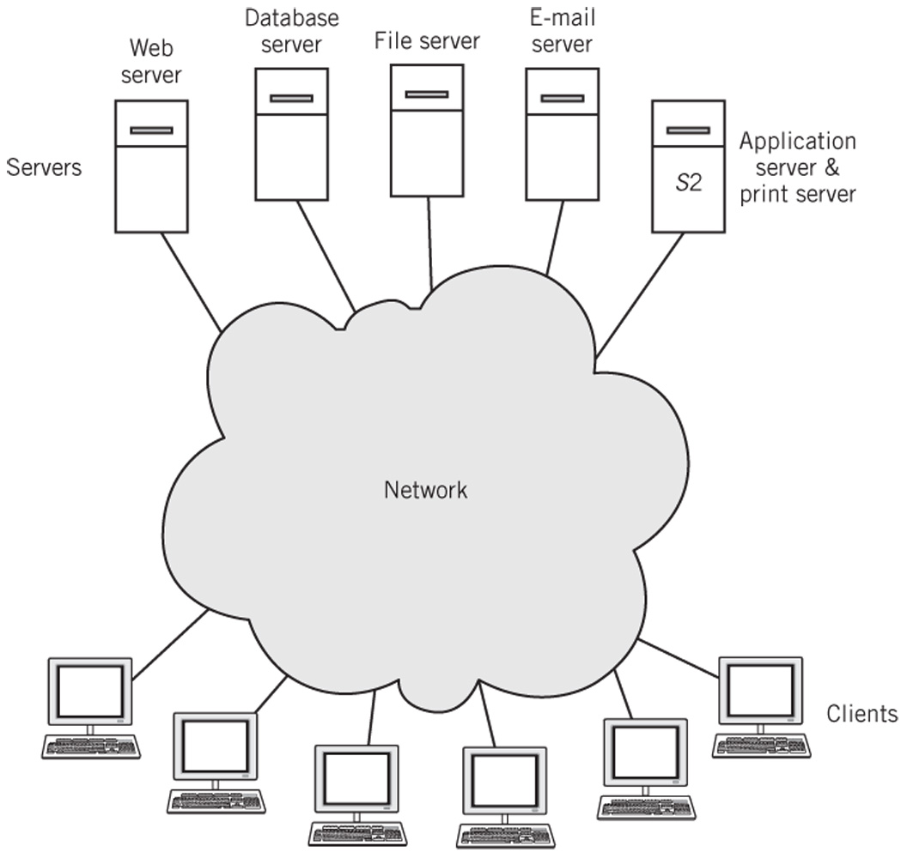
Clients and Servers on a Network
M:M relationship: A server can serve multiple clients. A client can request services from multiple servers.

Slide 19
Advantages of Client-Server Architecture
Centralization of services permits
easier administration of services by IT professionals
easier availability and location by users
consistency of resources, such as files and data, can be managed and assured
more efficient and cost-effective hardware procurement through purchasing a small number of very powerful computers

Slide 20
Multi-tier Architectures
Two-tier architecture
Two computers are involved in a service.
Example: Web-browser and Web server model used in intranets and on the Internet
Three-tier architecture
Three computers are involved in a service
Example: client computer, Web server, database server – Fig. 2.8, p. 54
N-tier architecture

Slide 21
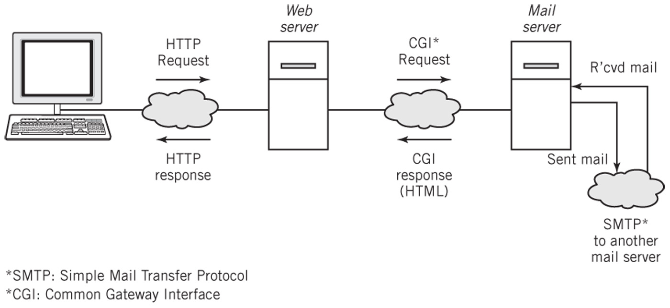
Three-tier Architecture

Slide 22
Middleware
In the client-server architecture different computer hardware and software can work together
Resolves potential incompatibilities between the application software, messages, data formats residing on the client and the server
Physically can reside on a server with other applications or on its own server
Improves system performance and administration

Slide 23
Peer-to-Peer Computing
Computers on a network are treated as equals
Each computer can share resources with the other computers on the network
Disadvantages
Difficult to establish centralized control of services
Difficult to locate services
Difficult to synchronize versions of files or software
Difficult to secure network from unauthorized access and from viruses
Advantages
Sharing files between personal computers
Internet file sharing

Slide 24
Hybrid Model of Computing
Client-server technology used to locate systems and files
Then systems can participate in peer-to-peer transactions
Examples
Instant messaging
Skype
Napster

Slide 25
Google: System Architecture
Provide powerful, fast search capability for material on the Internet
Derive income from advertising that is targeted to each user based on their searches
Basic requirements
Capable of responding to millions of simultaneous requests from all over the world
Perform a web crawl of the Internet retrieve and organize data
Establish ranking of results with appropriately targeted advertising
High reliability of the system
System is easily scalable and cost effective

Slide 26
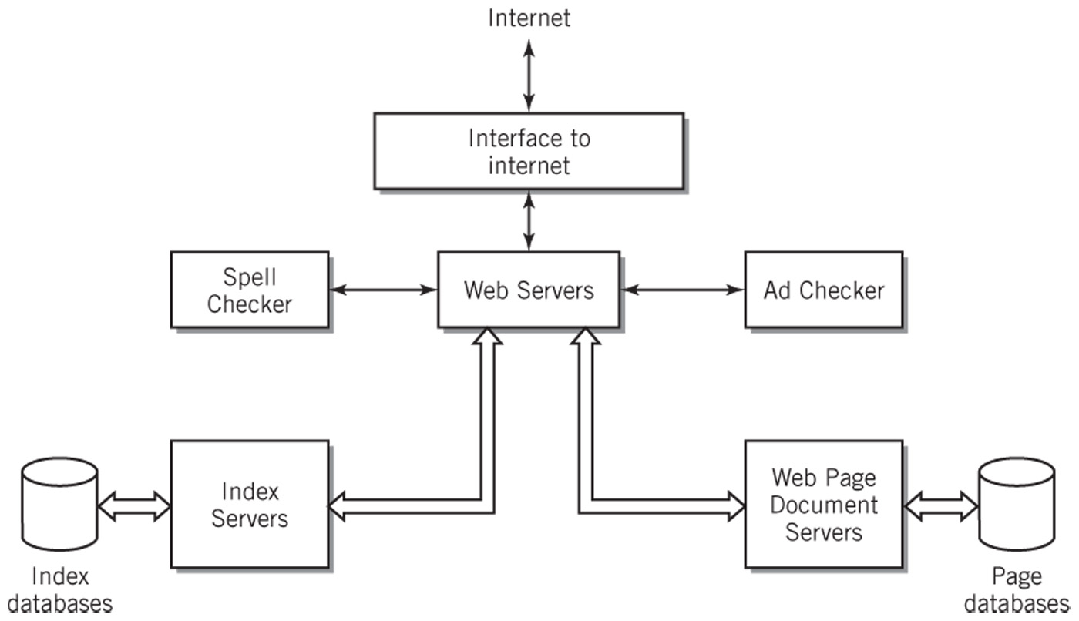
Google Data Center Search Application Architecture

Slide 27
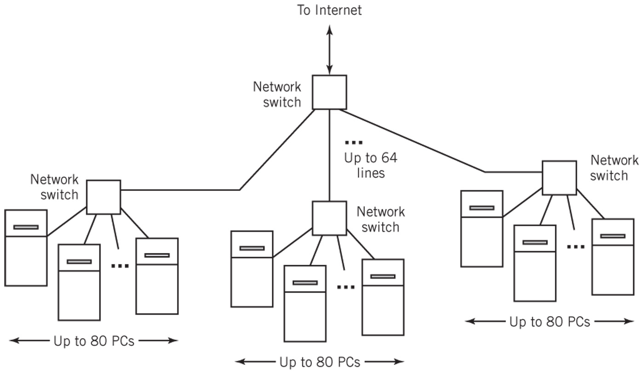
Simplified Google System Hardware Architecture

